Slide 1

OPTIMIZED WAREHOUSE MANAGEMENT OF PERISHIABLE GOODS FOR A FOOD DELIVERY COMPANY
MAJOR PROJECT
Presented By:
18UK1A05D5 - Gundavaram Rahul
18UK1A05B3-Thammishetty Soumya
18UK1A05D7-Jakkula Pausha
18UK1A05A3-Gunda Rohith

Slide 2

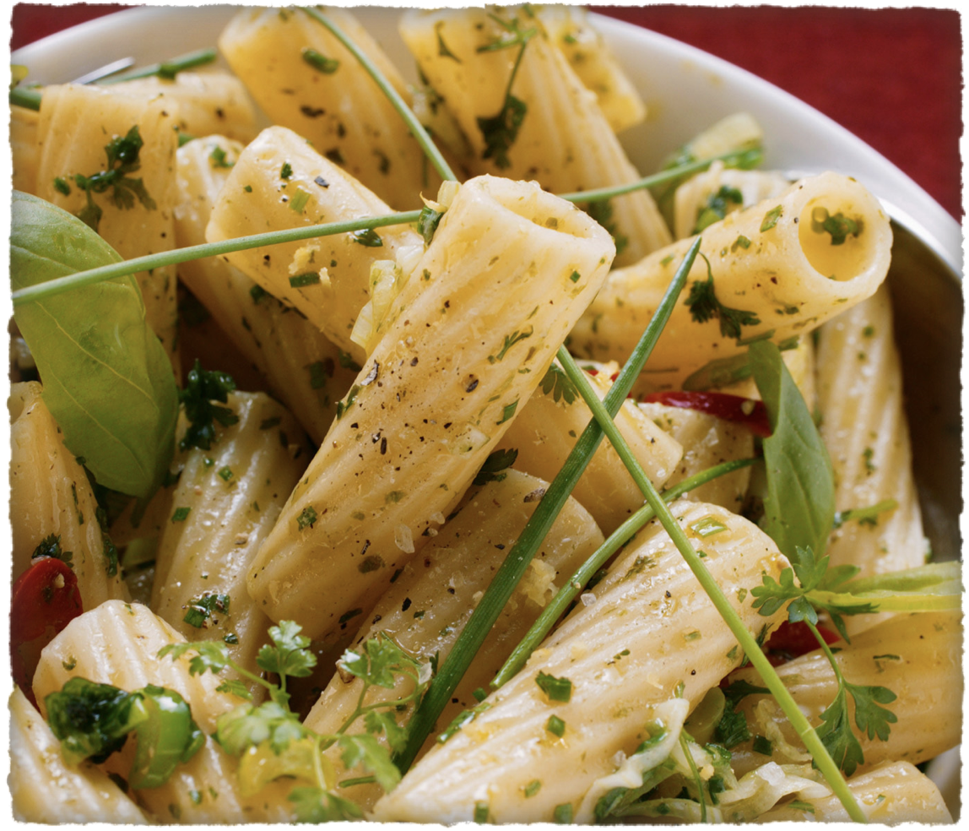

CONTENT
Introduction
Purpose
Existing problem
Proposed Solution
Block Diagram
Procedure
Software Requirements
Result
Conclusion
References

Slide 3
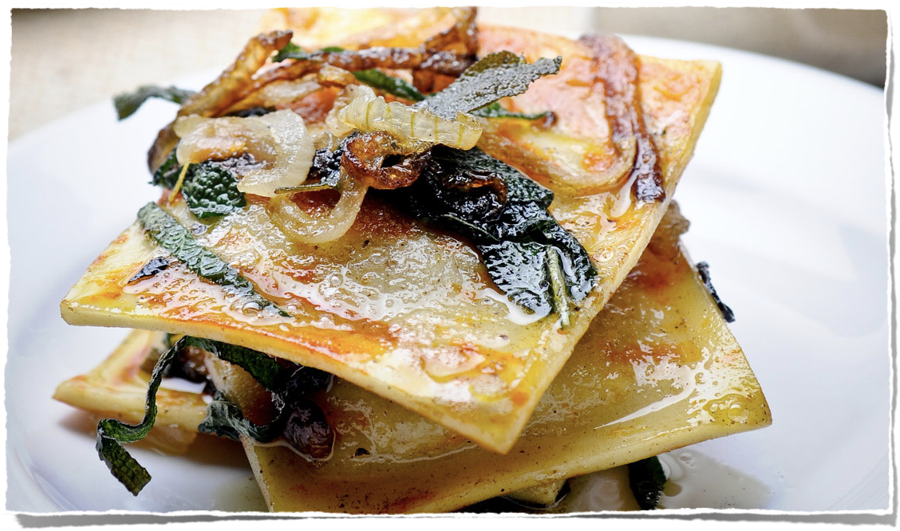
INTRODUCTION
The project Optimized warehouse management of perishable goods for a food delivery company helps all the food delivery companies to forecast the raw materials for the next 10 weeks. Being Computerized the system will be more helpful and provide companies at ease of stocking and keeping raw materials.
They are replenished enough according to needs and there is no shortage.

Slide 4
PURPOSE
One of the biggest challenges of food and beverage manufacturers is to adjust the production and the stocks to minimize the loss of products due to its short perishability.
Hence, time series analysis is very important in a wide range of applications, especially when it comes to forecasting, and it encloses many different forecasting models.

Slide 5
EXISTING PROBLEM
The food and beverage industry is one of the most important sector of any economy, with a signiﬁcant participation in GDP index. The food delivery companies have been worried about investing in planning their operations, making use, mainly, of forecasting methods in order to become more competitive in the market.
In the case of food industry, the seasonal and the short perishability factors are a limitation to the maintenance of stocks, requiring a forecast with a high accuracy level.

Slide 6
PROPOSED SOLUTION
The solution that we are proposing to this problem is a Machine Learning Model that analyzes the information as follows:
To forecast the raw materials for next ten weeks.
Assembling the data about fulﬁllment center like area, city etc., and meal information like category of food and should also have the information about number of orders of a particular category in particular week.
The algorithms used to train the Machine Learning Model are:
Linear Regression 5. K Neighbours Regressor
XGBRegressor 6. GradientBoostingRegressor
Lasso 7. Decision Tree Regressor
Elasticity

Slide 7
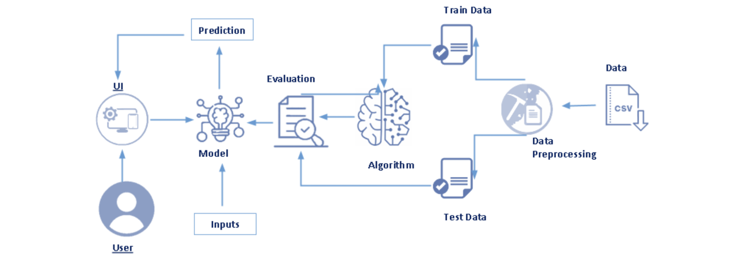
BLOCK DIAGRAM

Slide 8
PROCEDURE
The steps followed in developing the model are as follows:
Data Acquisition : We have downloaded the dataset from kaggle.
Data Visualization : Visualizing the different columns of the dataset by plotting graphs .
Data Preprocessing : Taking care of any missing entries and of any relations within the dataset.
Model Building : Developing a model with the help of different classiﬁcation algorithms to predict the raw materials for the next 10 weeks.

Slide 9
SOFTWARE REQUIREMENTS
For this we require the following :-
Anaconda-navigator==1.10.0
Flask==1.1.2
Tensorflow==2.5.0
Aslo we need few packages like:-
Pandas
Numpy
Pickle
OS

Slide 10
RESULT
The Food Demand Forecasting Model is analysed using the Decision Tree Regressor algorithm the predicted RMSLE value is 62.96 when compared with the other few algorithms.
The output pages are as follows:

Slide 11
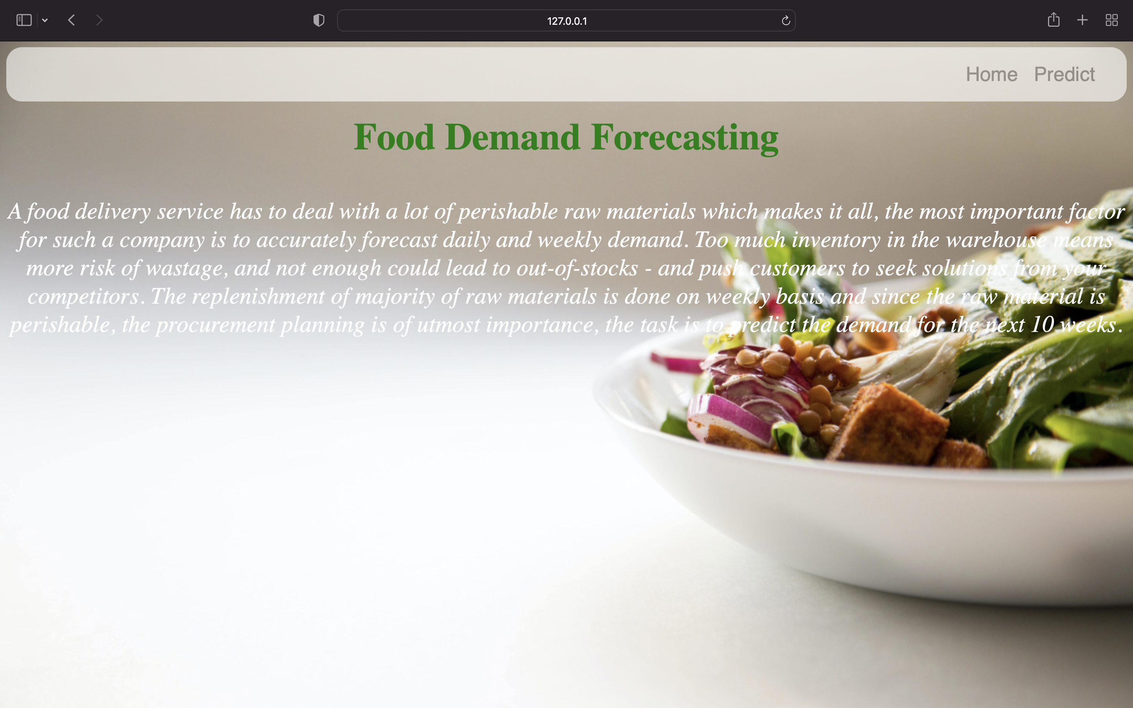
1.HOME PAGE

Slide 12
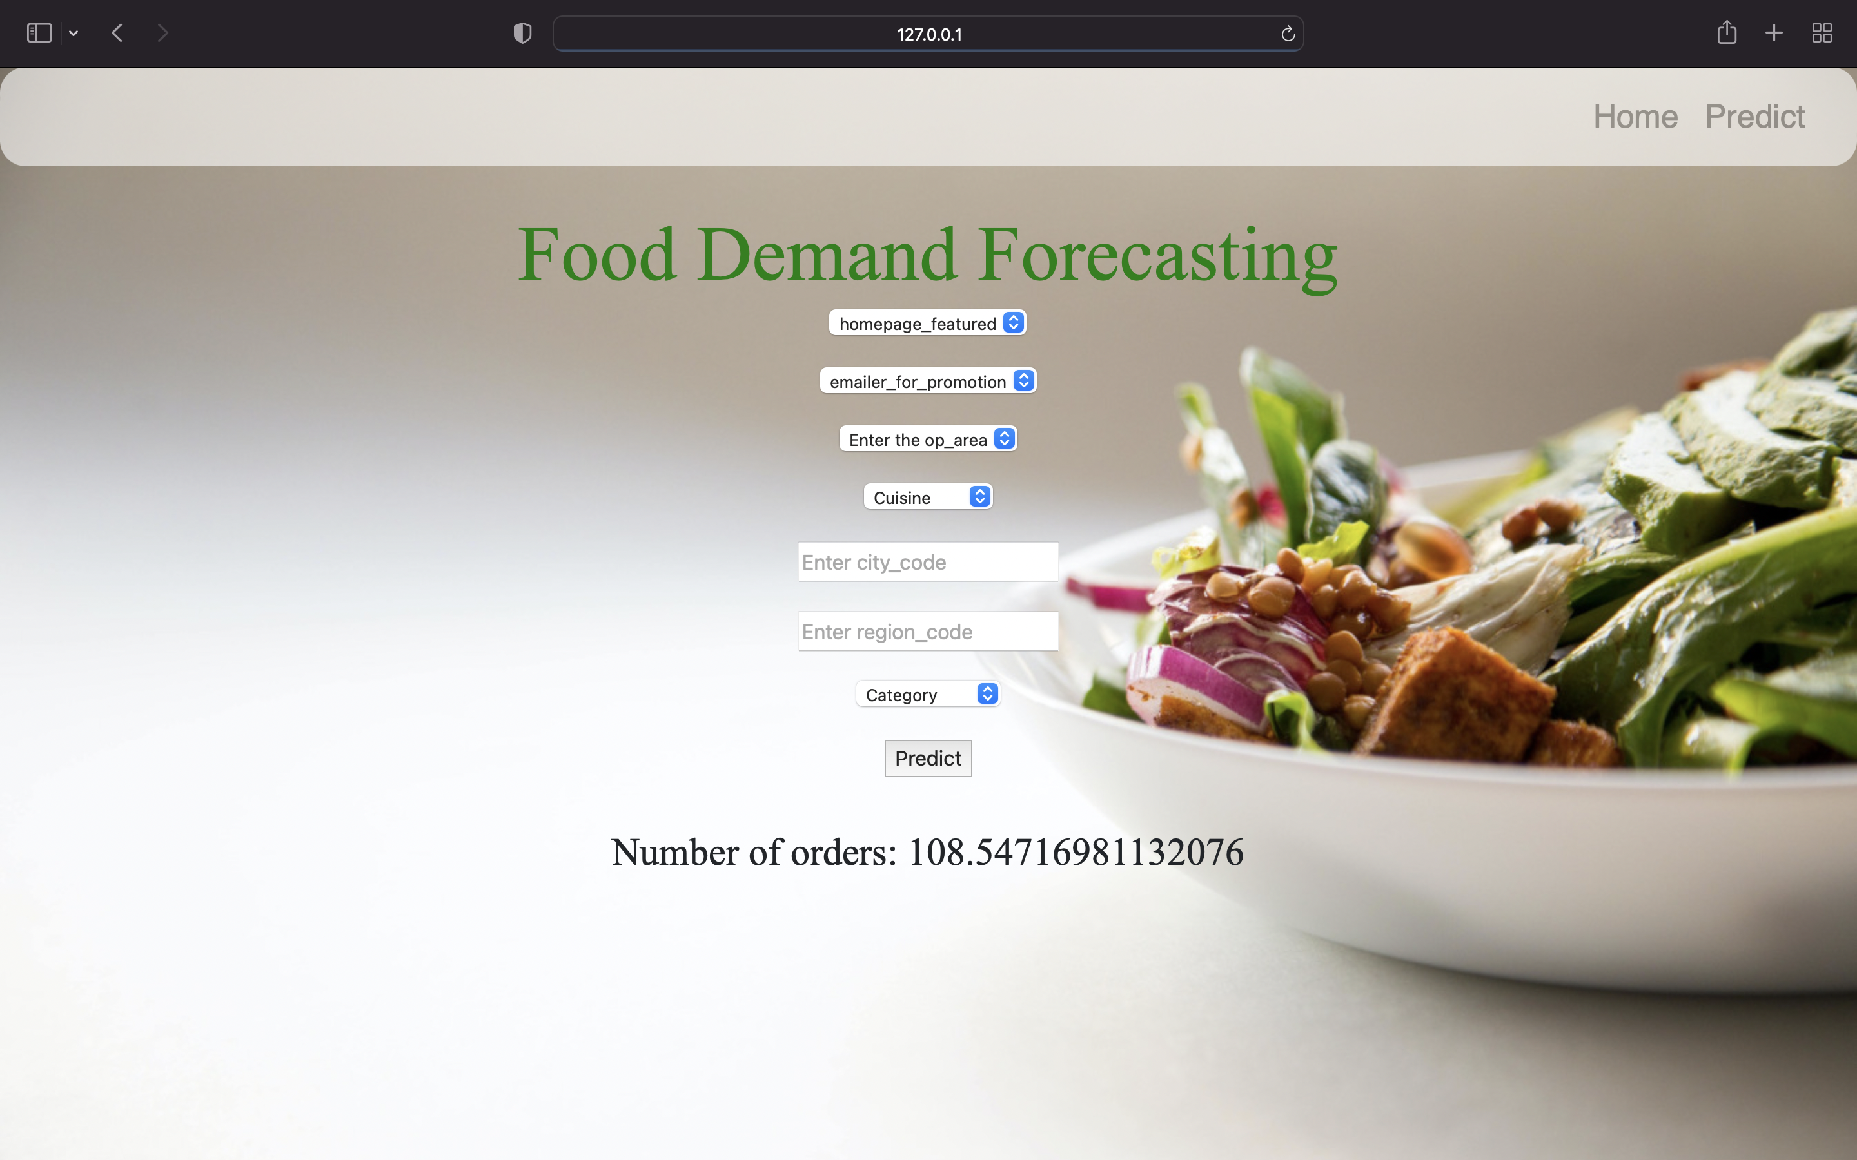
2.PREDICT PAGE

Slide 13
CONCLUSION
In this project , we have proposed methods for predicting the raw materials used in food delivery companies using Machine Learning techniques. The method that we used is Decision Tree Regressor.The system was implemented using the model and their performance was evaluated.A GUI was made based on the model for use in the medical industry.

Slide 14
REFERENCE
Alexandrov T., Bianconcini S., Dagum E. B., Maass P. and Mcelroy T. S. 2012 'A review of some modern approaches to the problem of trend extraction', Econometric Reviews, Vol. 31, pp. 593-624.
Ballou R. H. 2007. 'The evolution and future of logistics and supply chain management', European business review, Vol. 19, pp. 332-48.
Christo E., Ferreira M. and Alonso K. 2013. 'Use of Statistical Control for Improved Demand Forecasting', Computational Intelligence and 11th Brazilian Congress on Computational Intelligence (BRICS-CCI & CBIC), 2013 BRICS Congress on. IEEE.
De Oliveira Silva R., Da Silva Christo E. and Alonso Costa K. 2014. 'Analysis of Residual Autocorrelation in Forecasting Energy Consumption through a Java Program', Advanced Materials Research. Trans Tech Publ.
Eksoz C., Mansouri S. A. and Bourlakis M. 2014 'Collaborative forecasting in the food supply chain: A conceptual framework', International journal of production economics, Vol. 158, pp. 120-35.

Slide 15
THANK YOU

